Slide 1



Keep Password application developed during training at Ministry of Communications and Information Technology.
Name:
Tahani Abdulaziz Almanaa

Slide 2
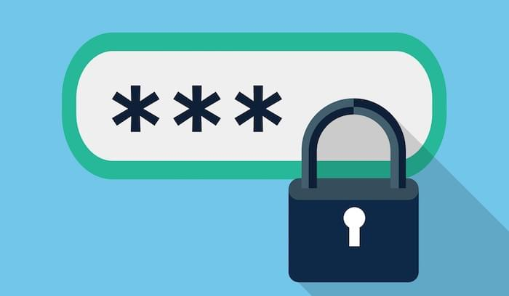

Sometimes you lose some of your passwords!
I decided to create an application using the Java language to save all your passwords.

Slide 3





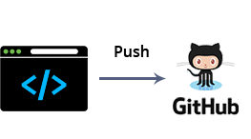
System Architecture and Scope:
I will work on the back-end of the application by using java language.
Java is a high-level, class-based, object-oriented programming language that is designed to have as few implementation dependencies as possible.
also, Java code can run on all platforms that support Java without the need for recompilation.
As of 2019, Java was one of the most popular programming languages in use according to GitHub.

Slide 4
Application advantages
It's free, you don't need to pay for the service.
Keep Password app can run on all platforms that support Java.
It's open-source, when finished it will be published on GitHub.
Easy to use.
More Security.
Add other languages for App.

Slide 5


The applications similar :
Passwords are simple. They're either too easy to guess and using the same one everywhere is inviting hackers to take down all your accounts at once. Therefore, password managers are a good idea.
The Keep Password Application is distinguished from them by:
It Open-source and will publish on GitHub.
It will Free opposite for the service.
It will run on all platforms and desktop app.

Slide 6

The Goal Of Project :
Is self-development in building an application by using Java, IntelliJ IDEA, Spring boot, Postman, MongoDB and Docker.

Slide 7
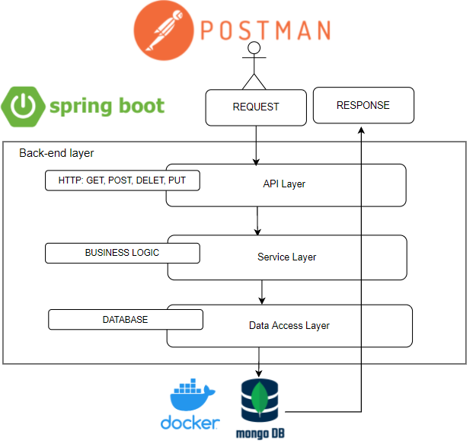
Back-end Layer diagram

Slide 8
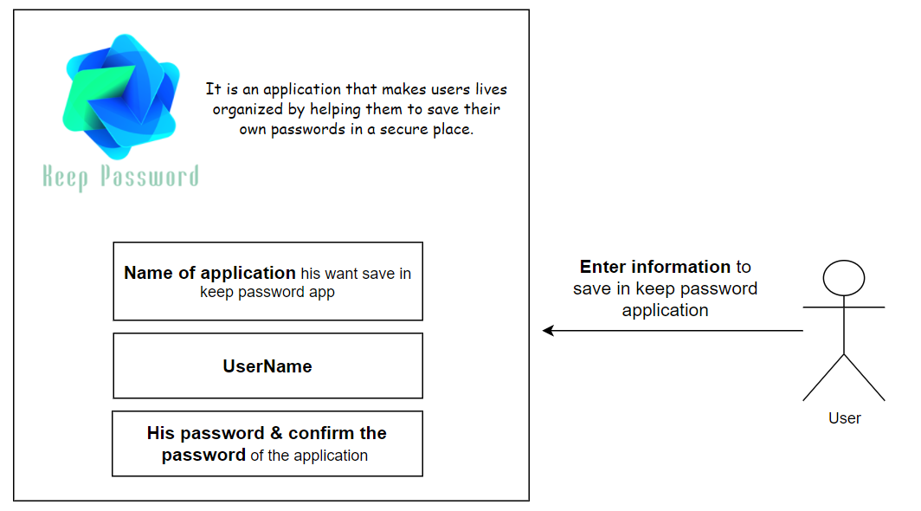
Use Case Diagram

Slide 9
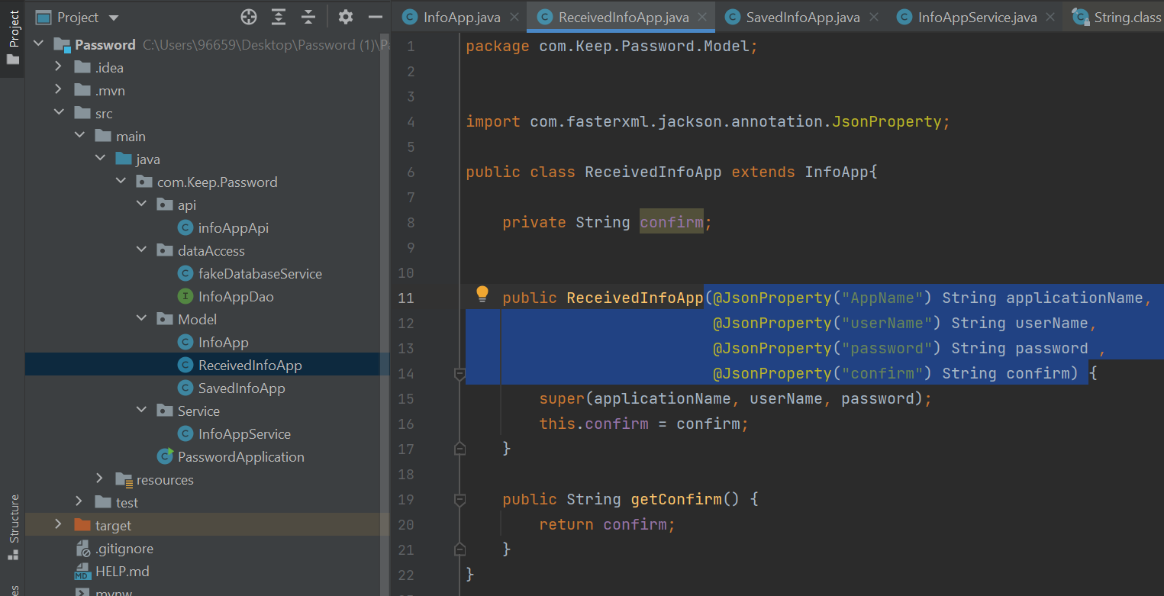
Some the screenshot of code and run
The information entered by the user is sent to the InfoAppService class to verify.

Slide 10
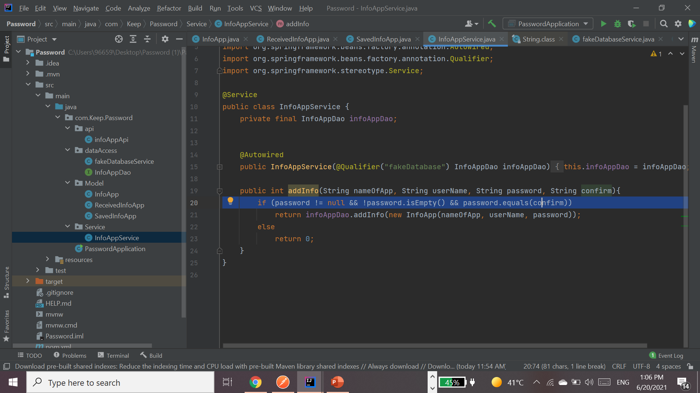
This condition
verifies that the password entry and confirmation match, in which case they are saved to the DB.

Slide 11
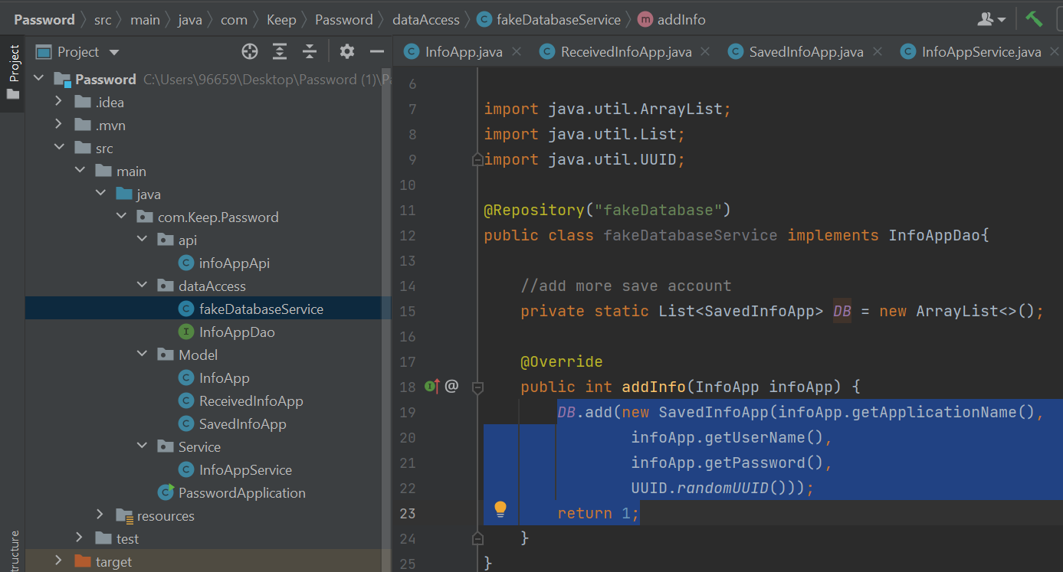
The information is added to the DB, returns 1 and means that the operation was successful.
Each user has a unique number that is dealt with in the database in terms of adding, updating, deleting ... etc.

Slide 12
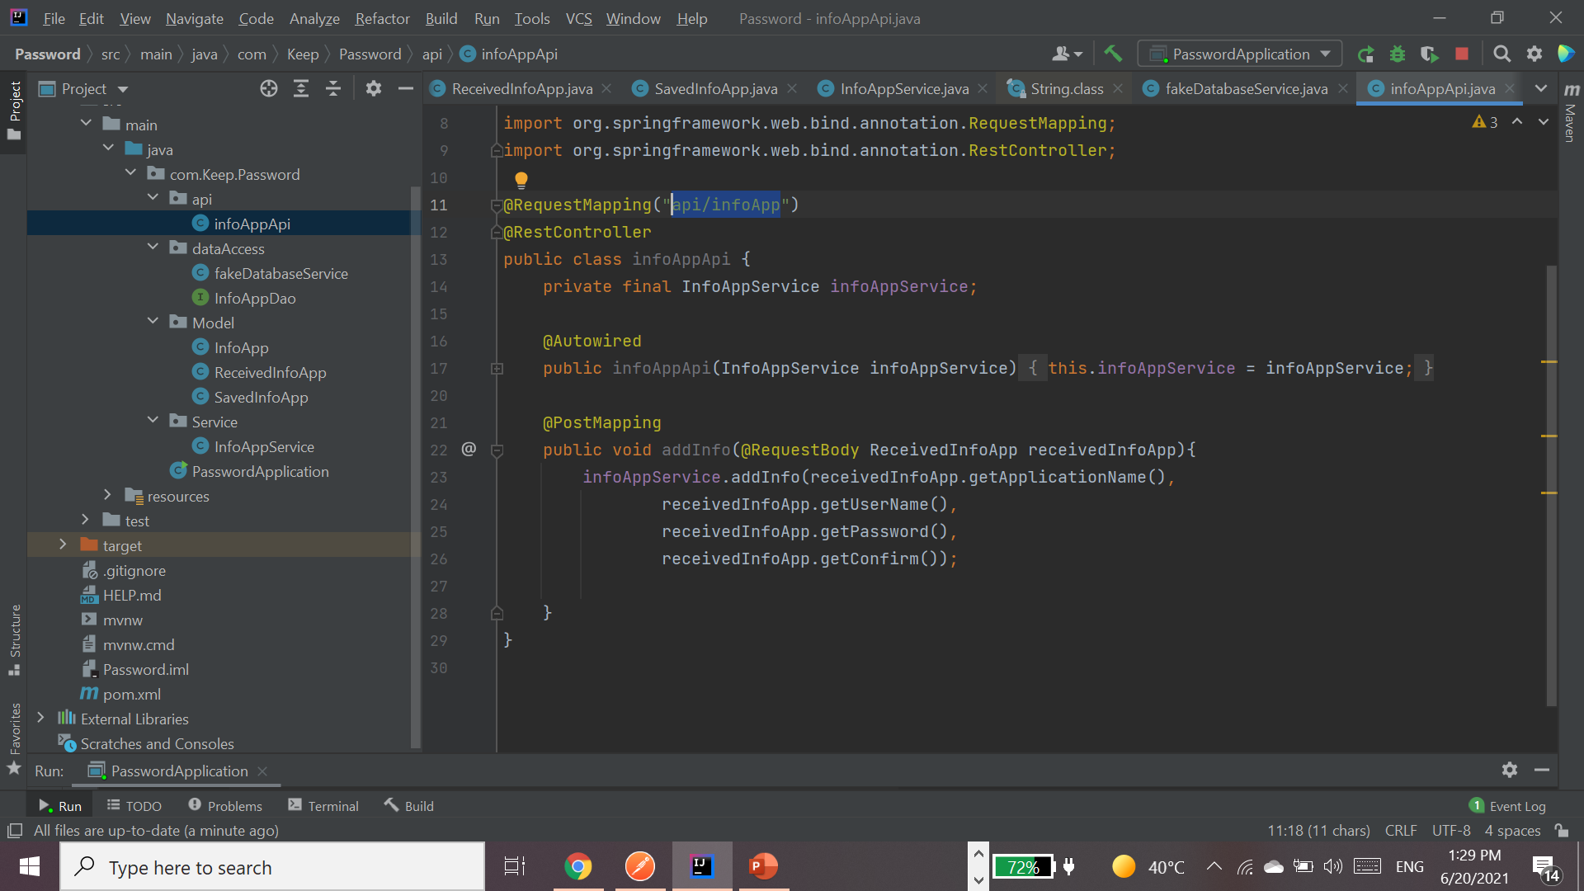
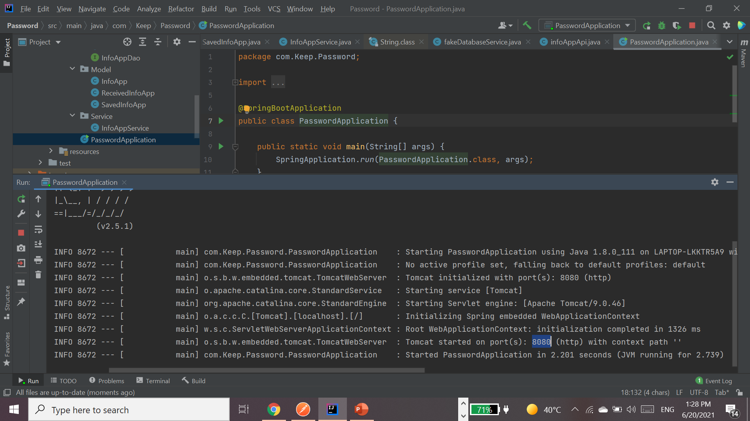
Run ..
The port and path are added to the postman address bar.

Slide 13
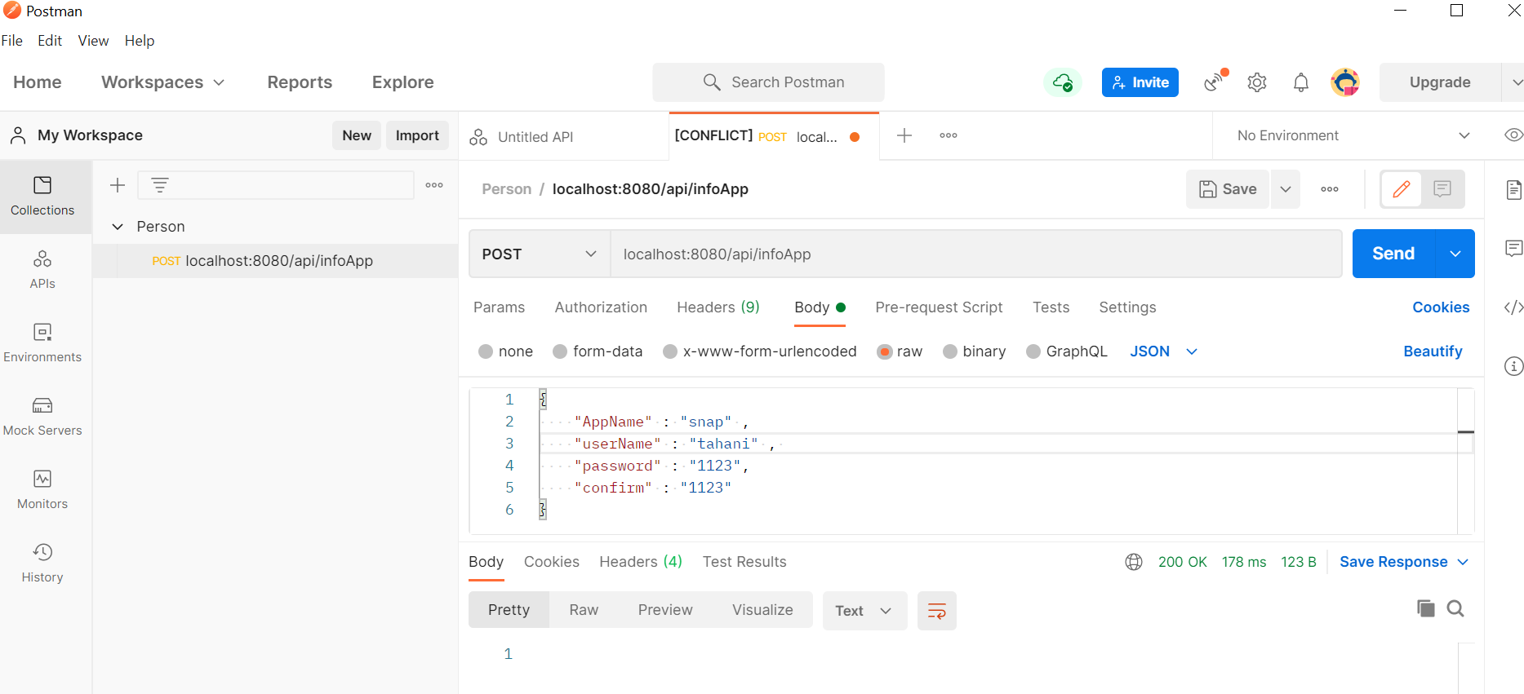
“1- Add in the DB”
In Case True
Was return 1,
that the information entered complies with the conditions.

Slide 14
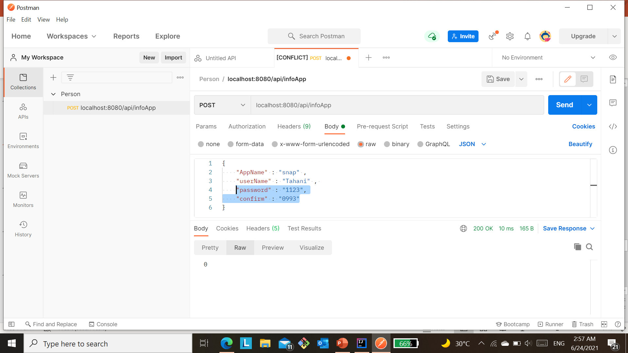

0 is returned, that the information entered does not comply with the conditions.
In Case False:

Slide 15
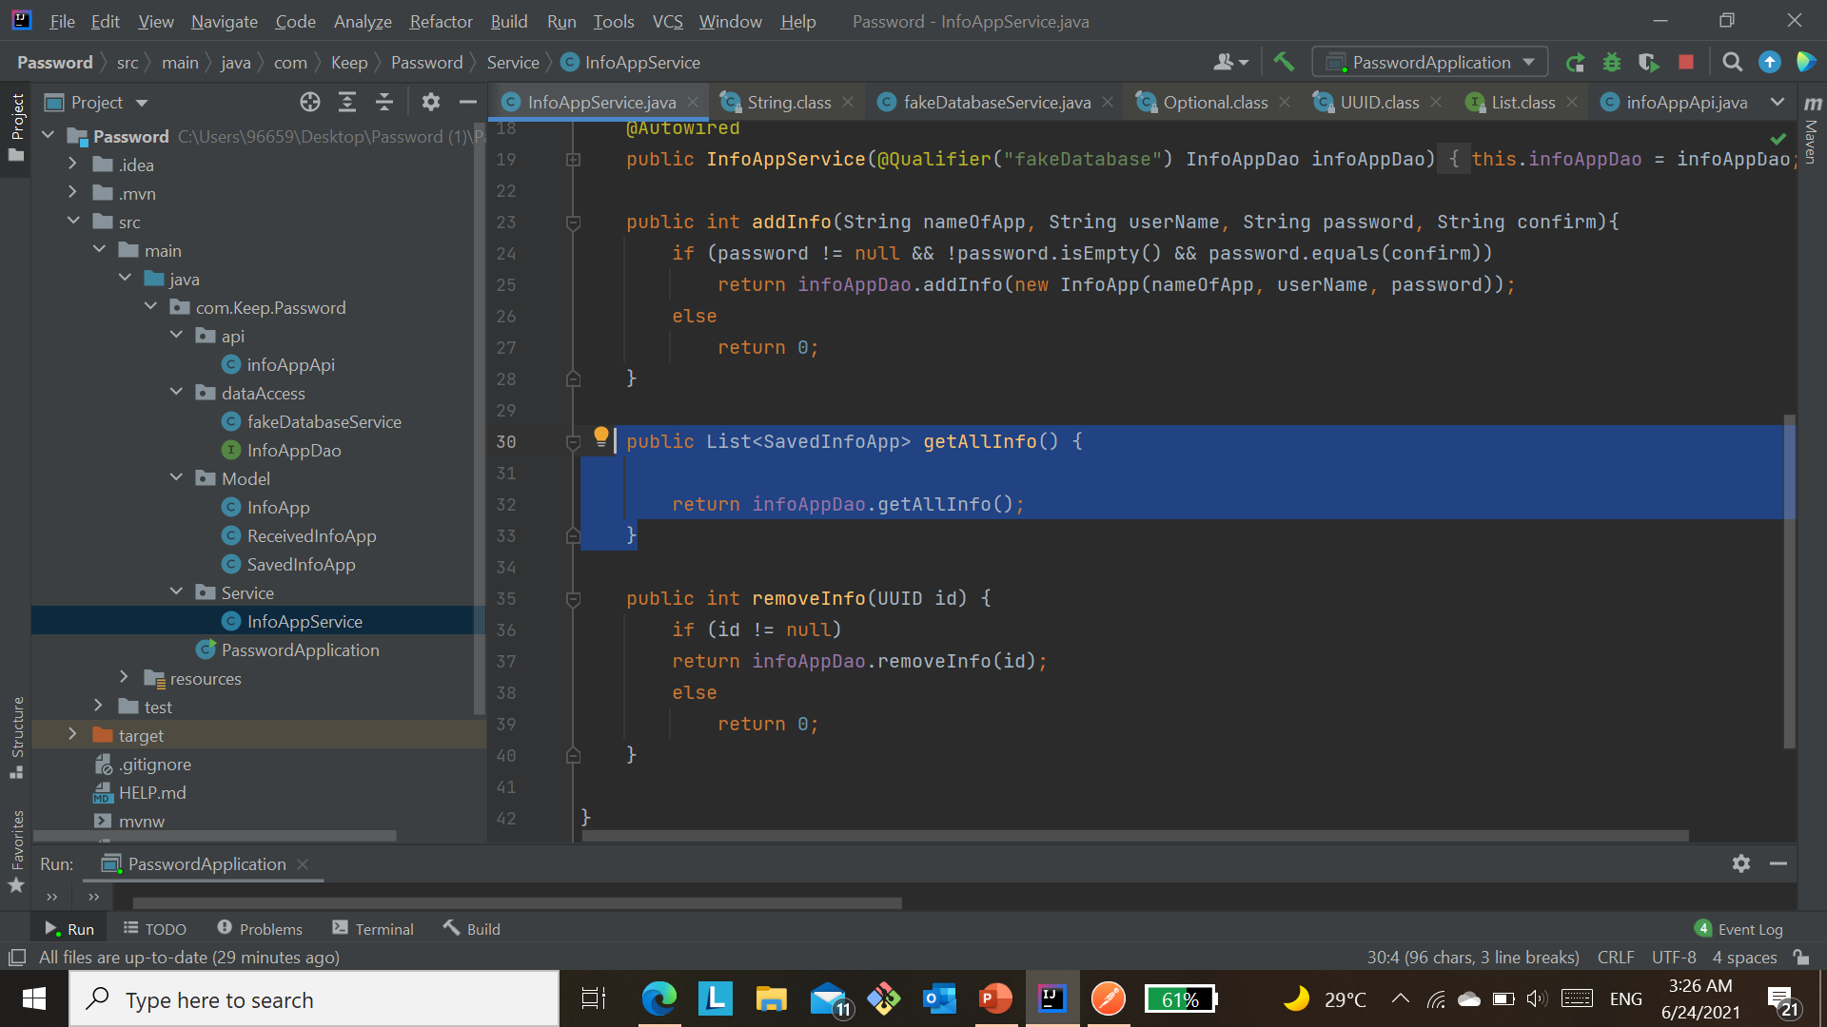
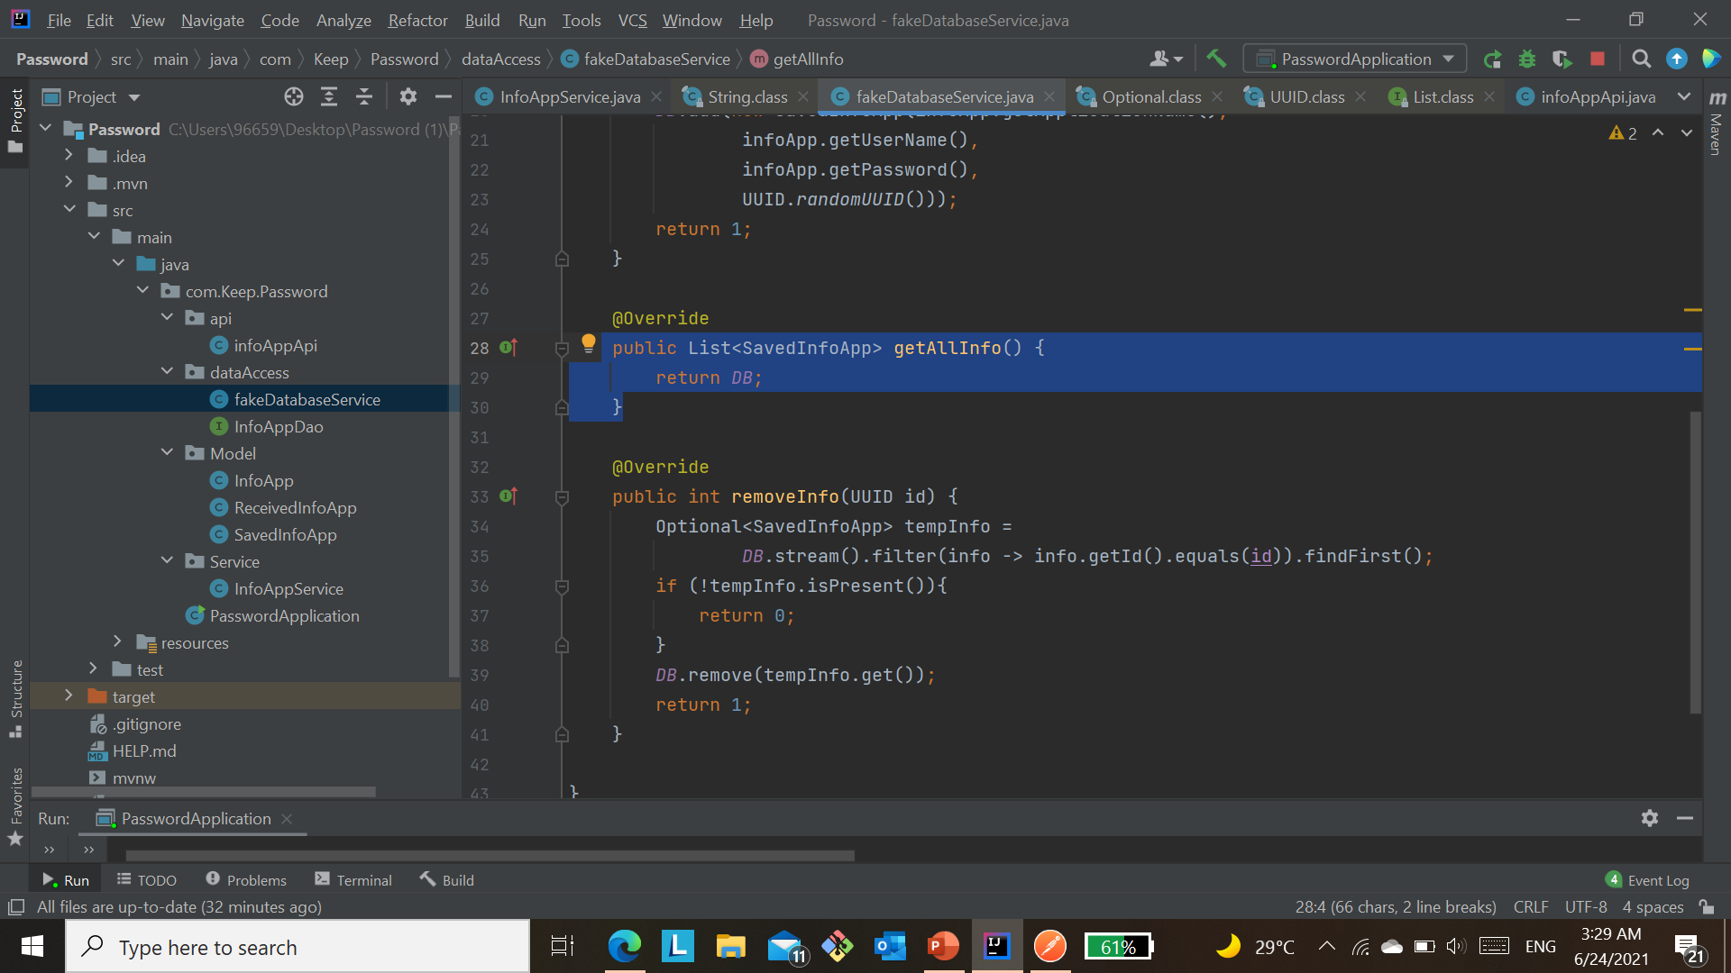
This function return all users in the database.

Slide 16
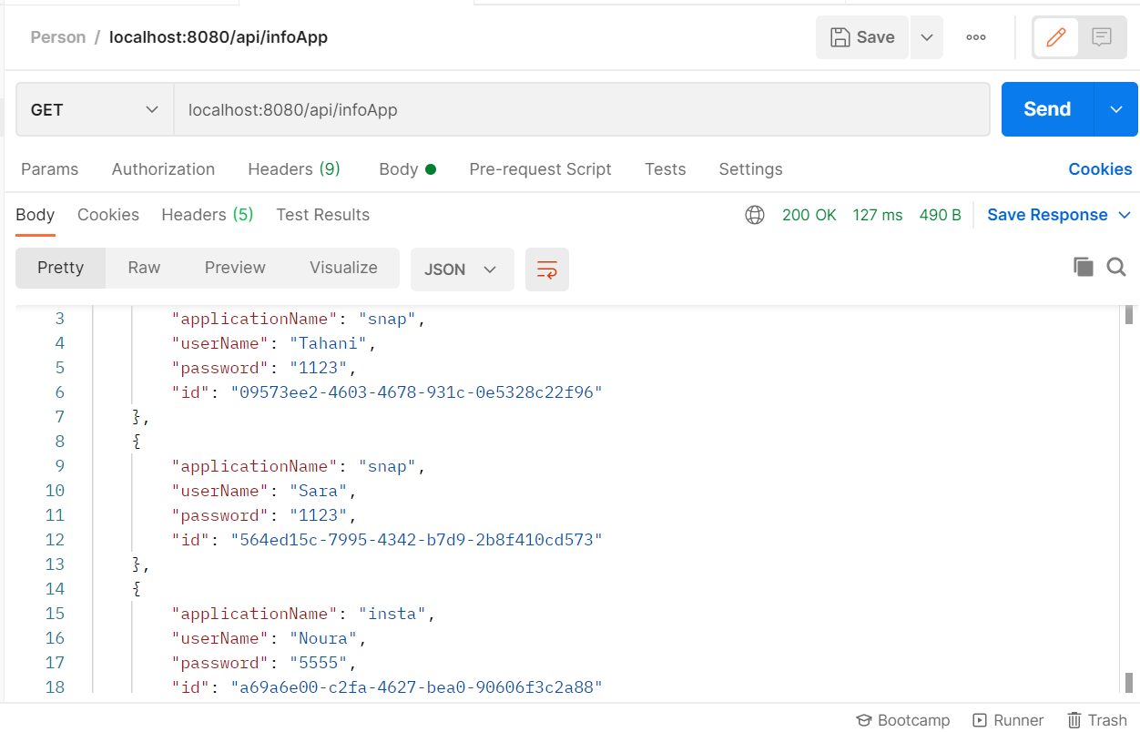
2- Retrieve all users from the database.

Slide 17
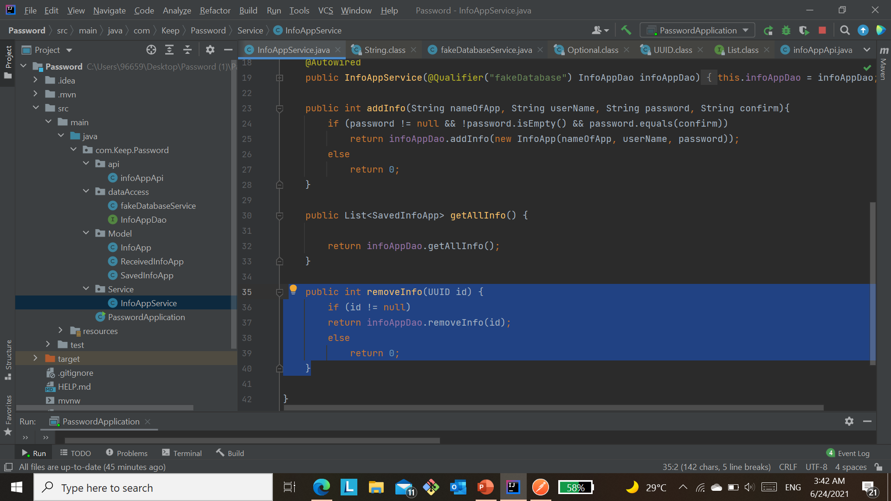
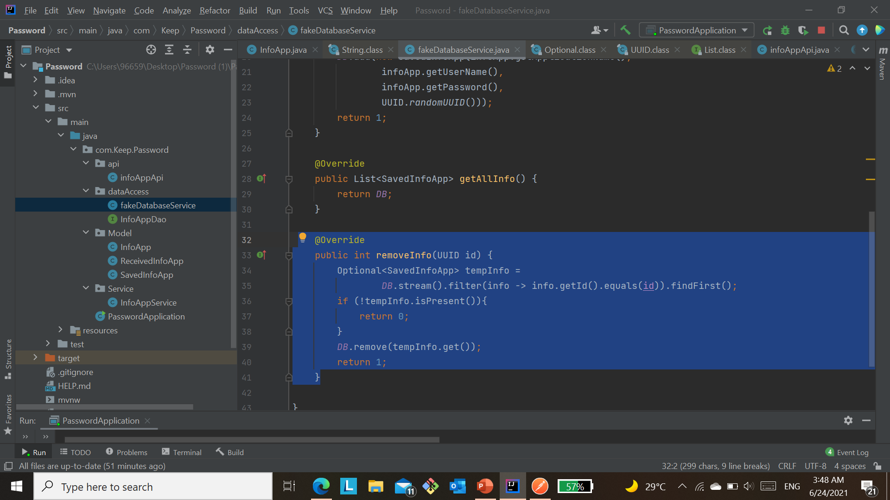
This function is used to delete a specific user by ID from the database. In the case that the ID is not null, it is sent to the deletion removeInfo method. Else, it returns with zero.
3- Delete by ID.
When the id in the parameter matches the first identifier from the database, in this case, it is deleted and the number 1 returns, indicating that the deletion process has been completed.
But if it doesn't find the ID, it returns zero.

Slide 18
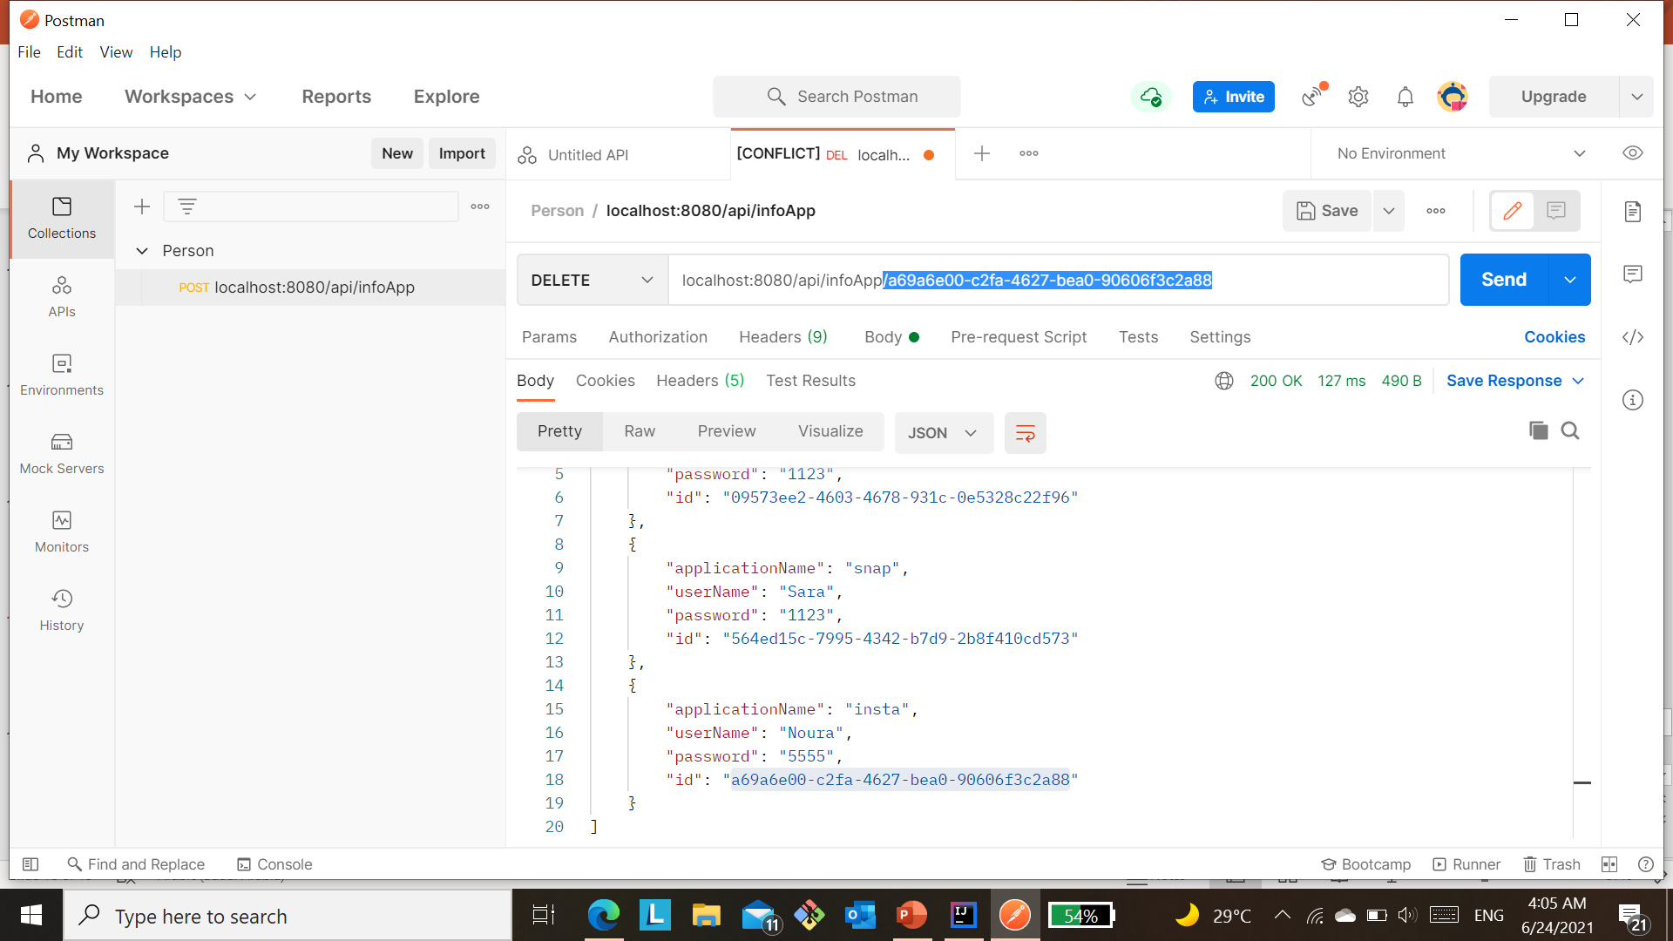
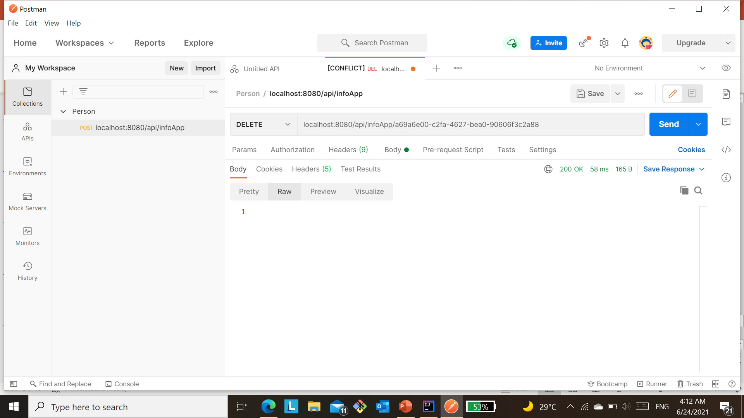
#3
#2
#4
#1
The ID to be deleted is selected, placed in a tape, then delete, and thus send.
Is returned 1 if the ID is present and has been deleted

Slide 19
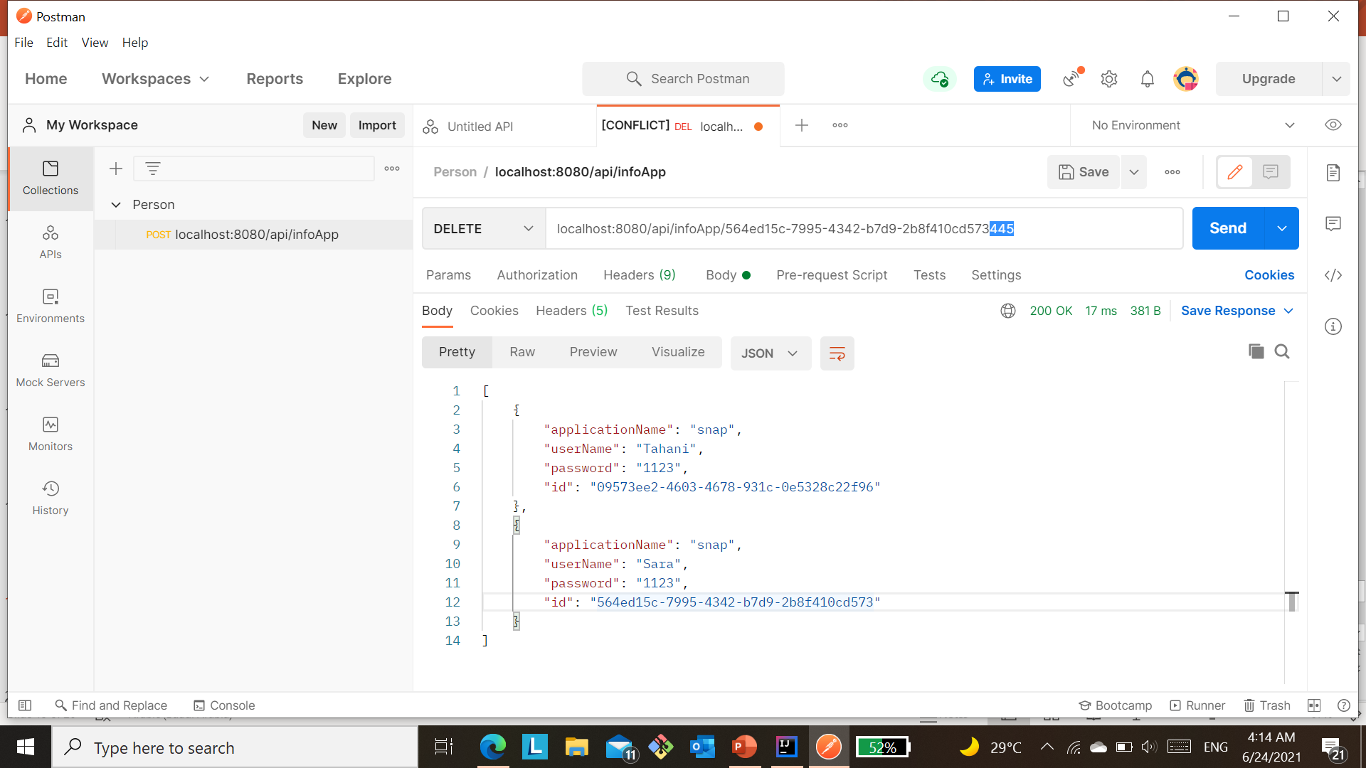

If the matching ID is not found, will be returned 0.
not match

Slide 20
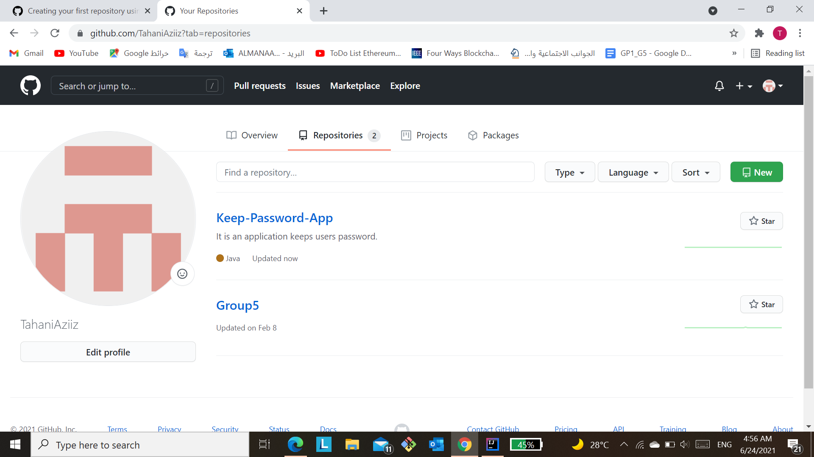

Publish The First Version:
The first version was published in GitHub, that contains the function of "add, get, and remove".
Link: https://github.com/TahaniAziiz/Keep-Password-App

Slide 21
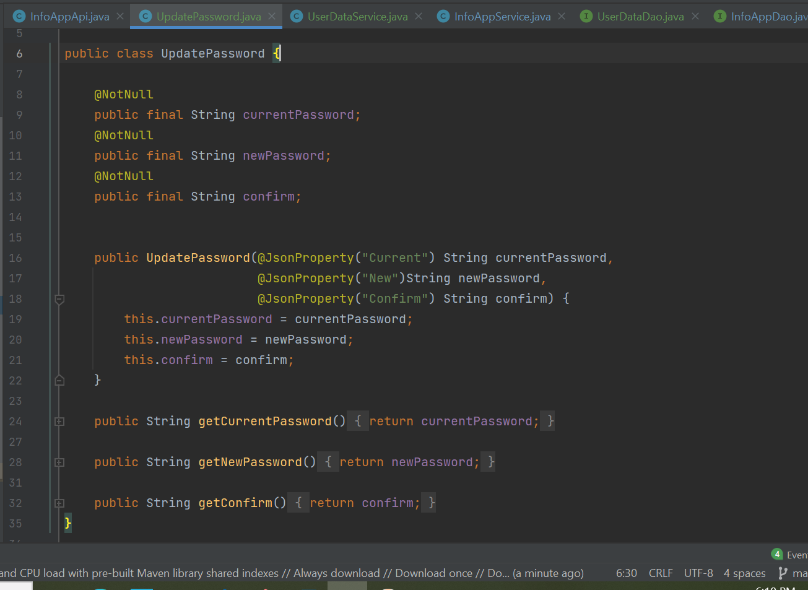
4- Update.
The UpdatePassword class requires three inputs:
Current password.
New password.
Confirm password.

Slide 22
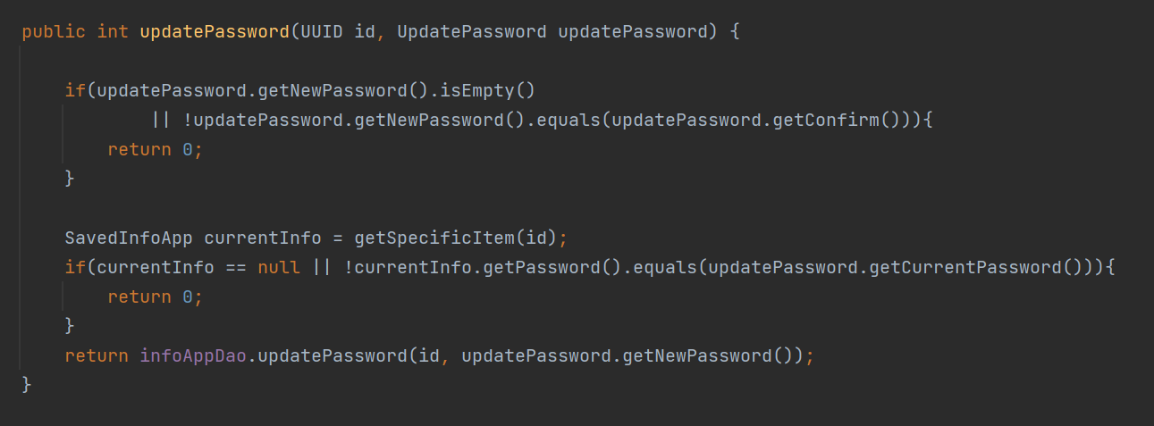
1- Update Password Method
In the condition that the new password is empty, or the new password is not equal to the confirmation password, it returns 0.
If the current password is empty or the current password is not equal to the entered password, it returns 0.
Otherwise, the ID and new password will be sent to updatePassword() method.

Slide 23
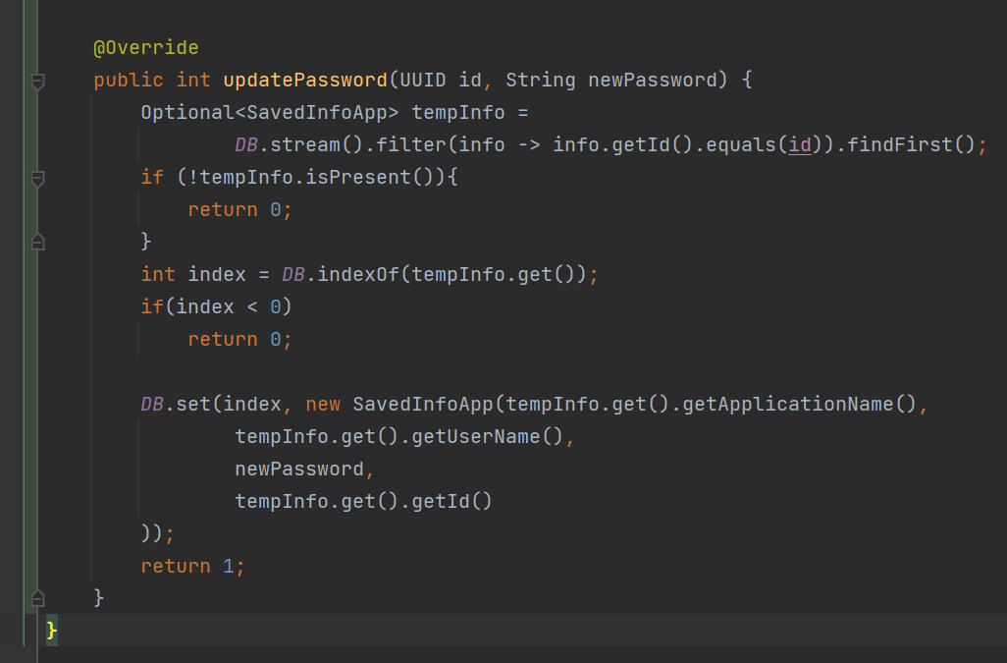
The first ID that matches the sent ID will be saved in tempInfo.
If there is no contains ID in tempInfo, will return 0.
Otherwise, the password will be updated in the Database through the DB.set() and return 1.

Slide 24
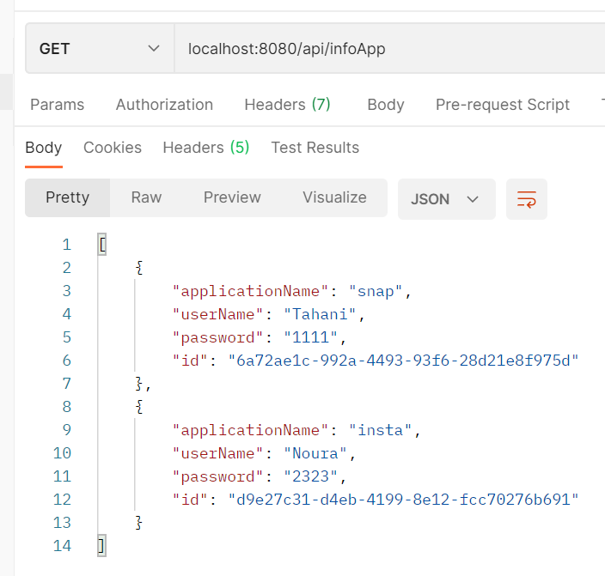
This is the previous database before the password update.
The password will be updated by selecting the required ID.

Slide 25
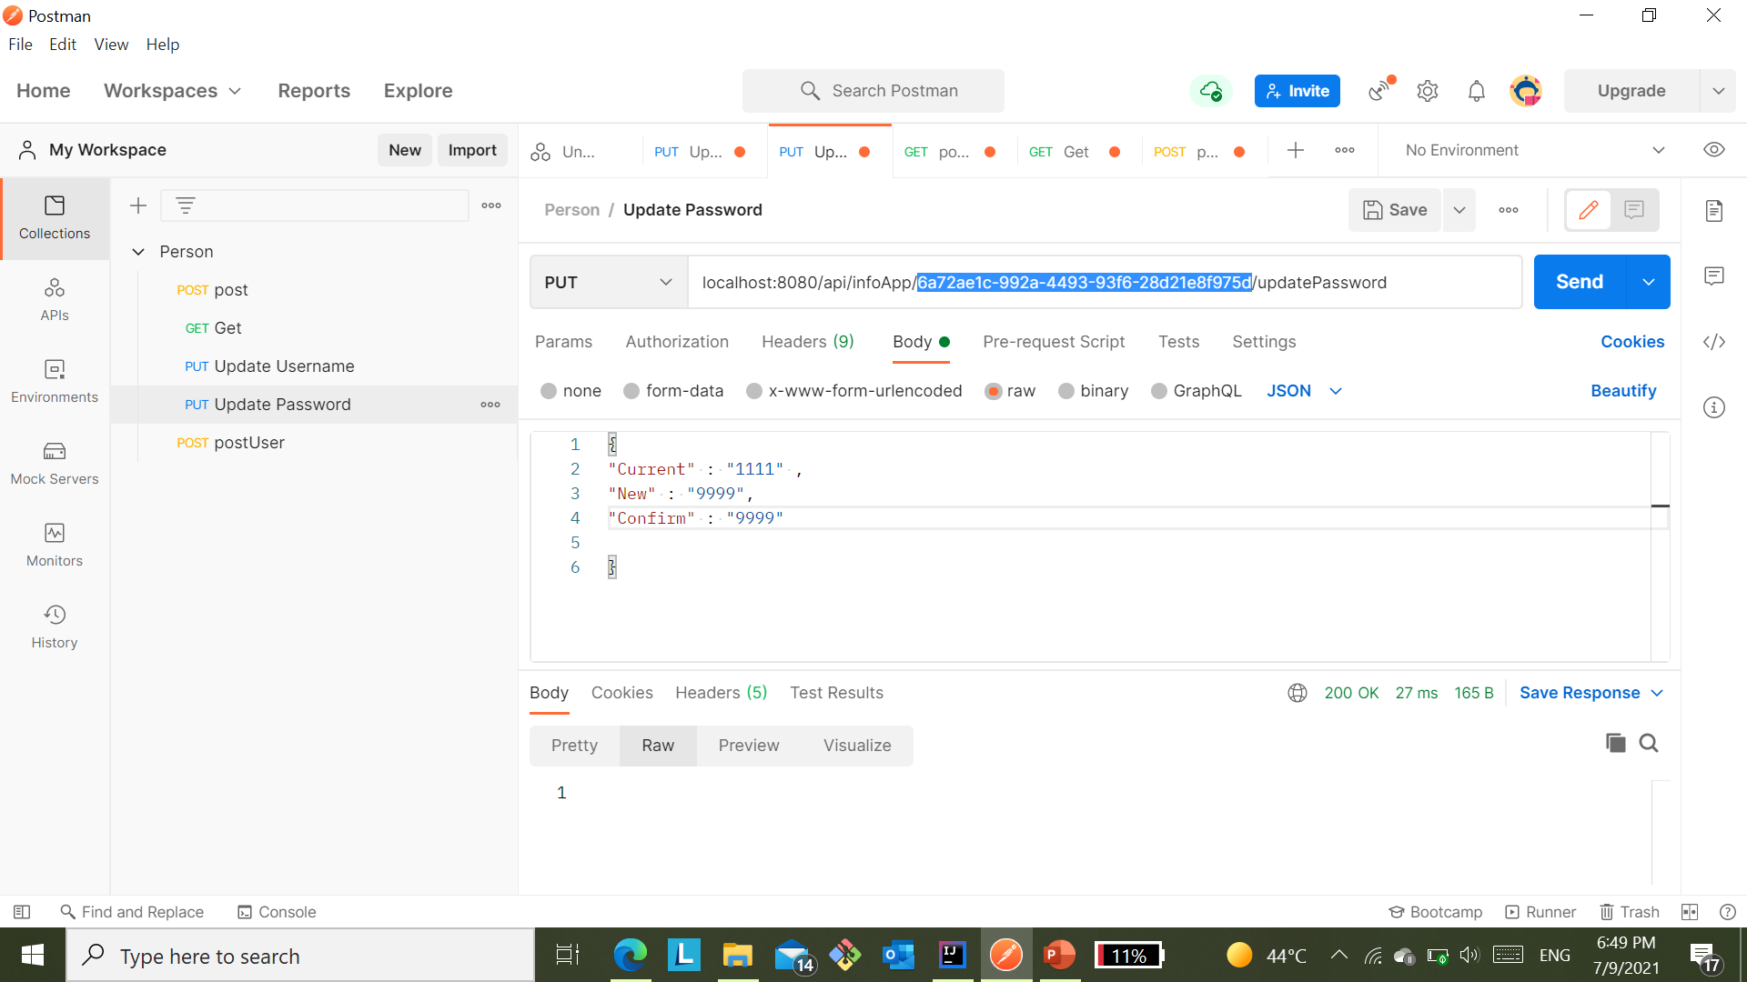
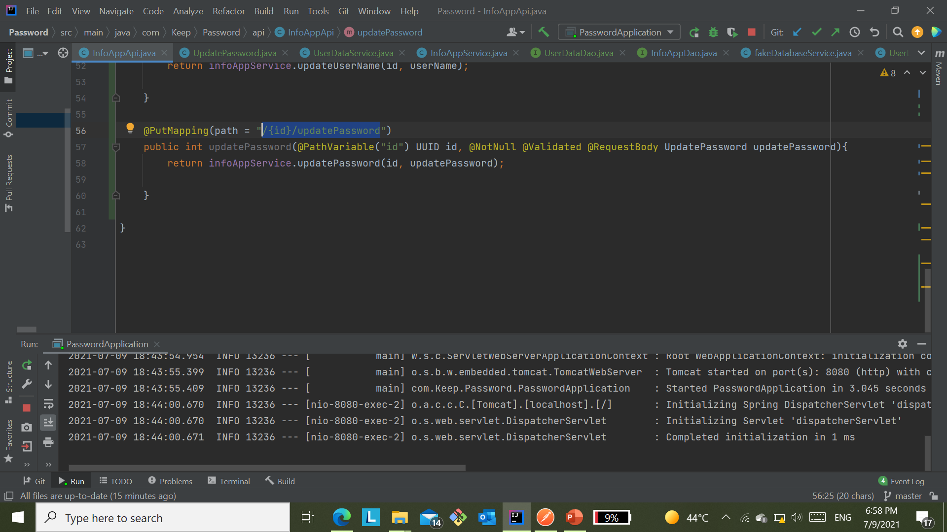
#1
Password updated by:
Enter the ID and the path in the bar.
Write in the body {
Current password
and new password
and confirm password }
and return 1 that this has been updated in database.
#2

Slide 26
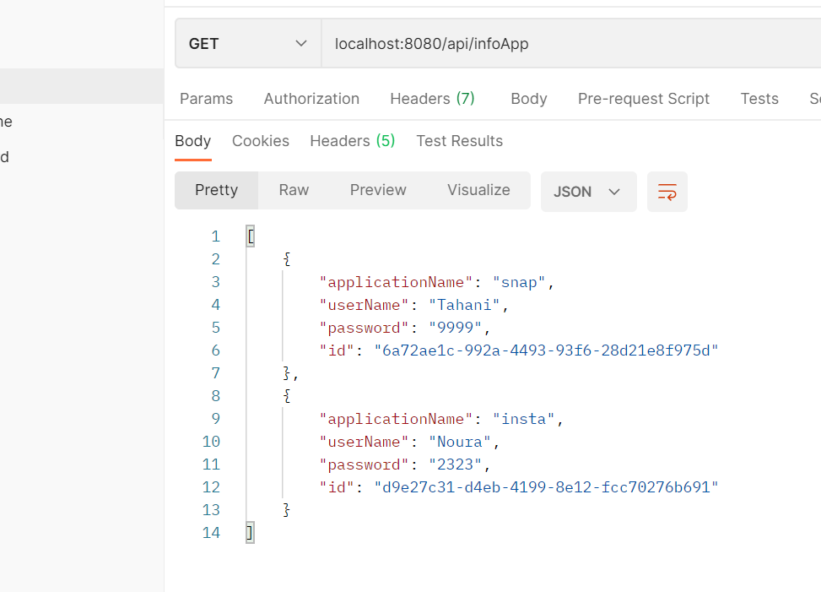
This is the new database after updating the password 1111 to 9999.

Slide 27
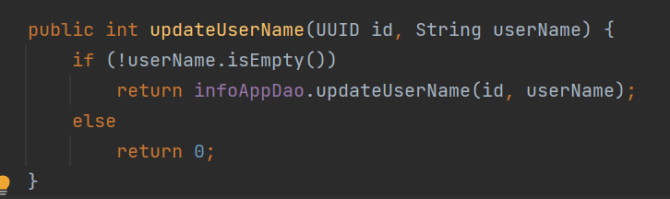
2- Update User Name Method
The condition checks that the username is:
not null in this case, it will be sent id and userName to the updateUserName method.
Otherwise, will be return 0

Slide 28
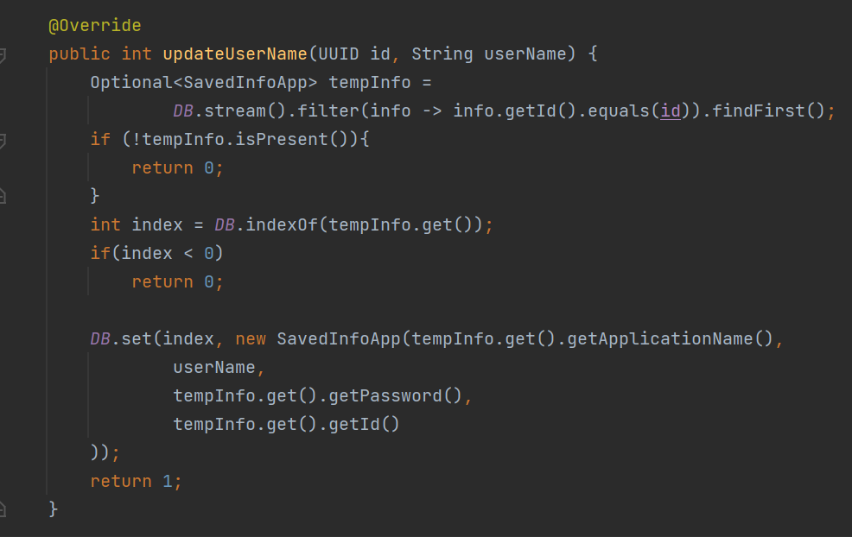
The first ID that matches the sent ID will be saved in tempInfo.
If there is no contains ID in tempInfo, will return 0.
Otherwise, the username will be updated in the Database through the DB.set() and return 1.

Slide 29
Previous database before update username.

Slide 30
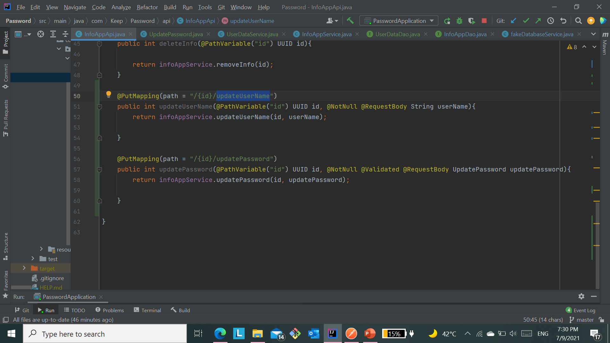
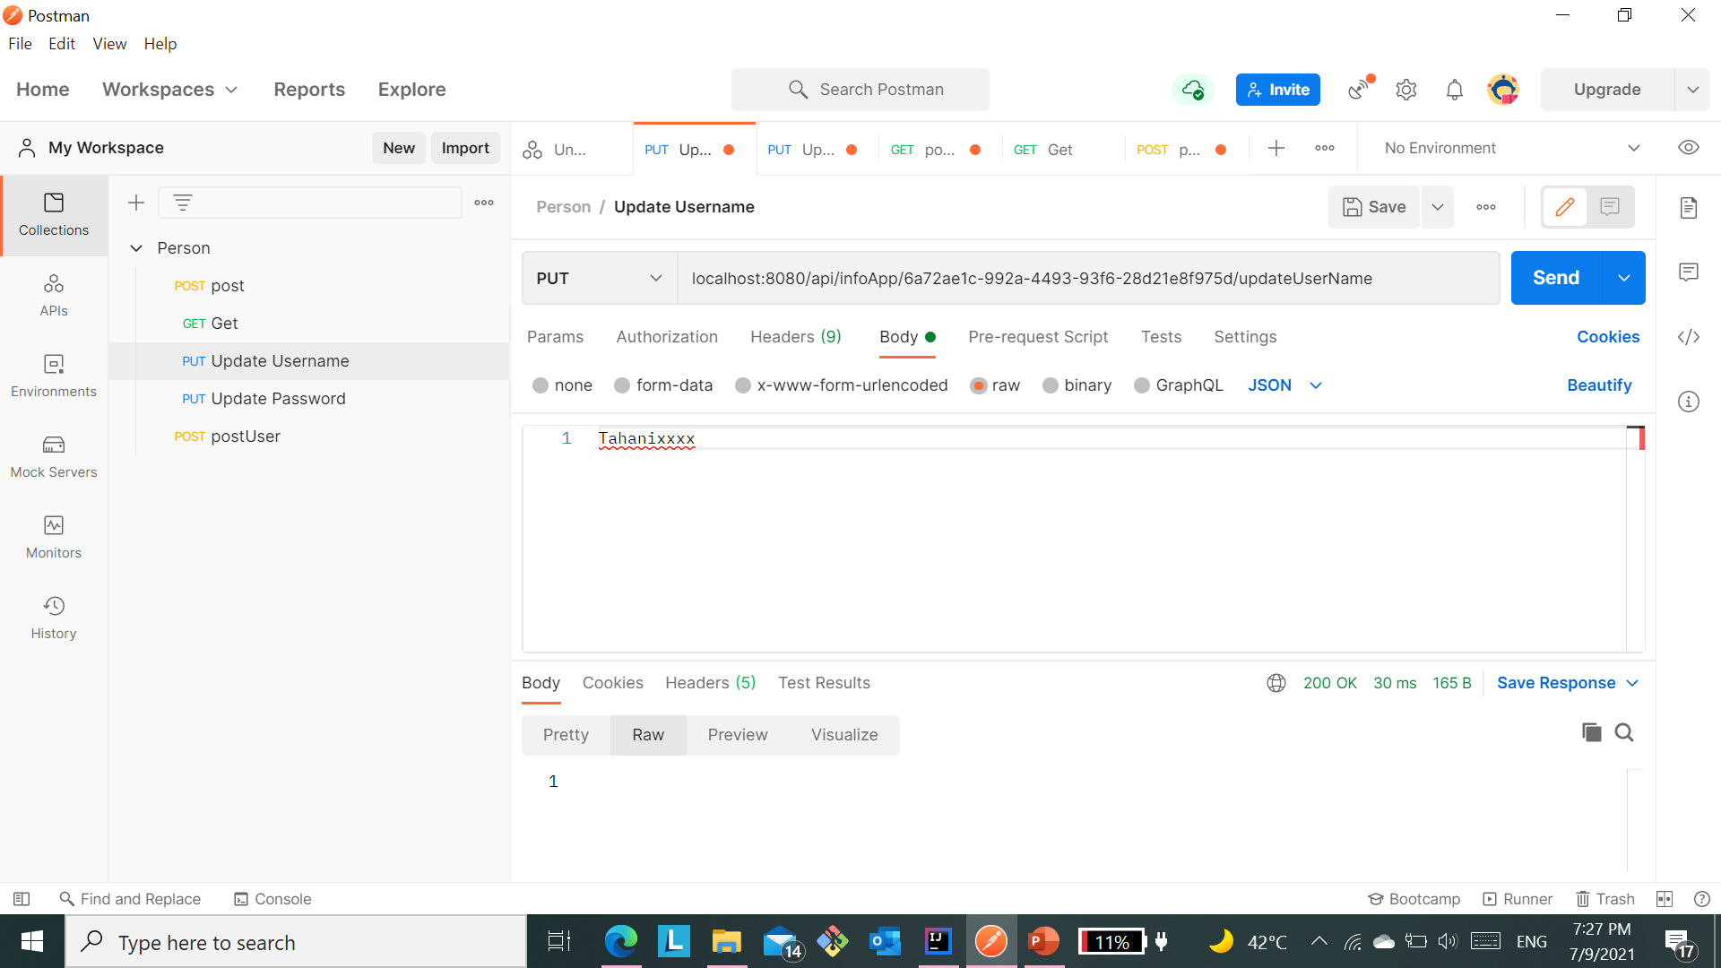
#1
UserName updated by:
Enter the ID and the path in the bar.
Write in the body:
user name
#3
#2
return 1 that this has been updated in database.

Slide 31
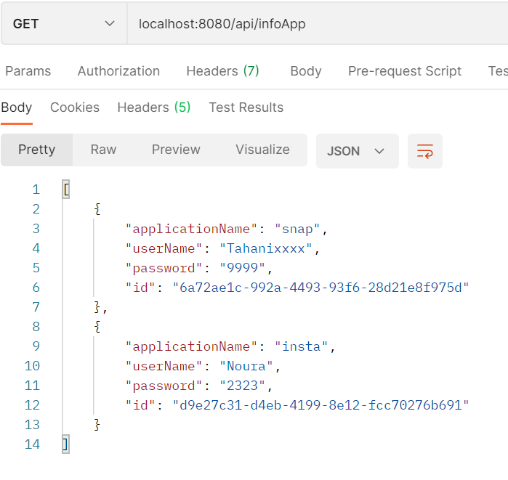
This is the new database after updating the userName Tahani to Tahanixxxx.

Slide 32
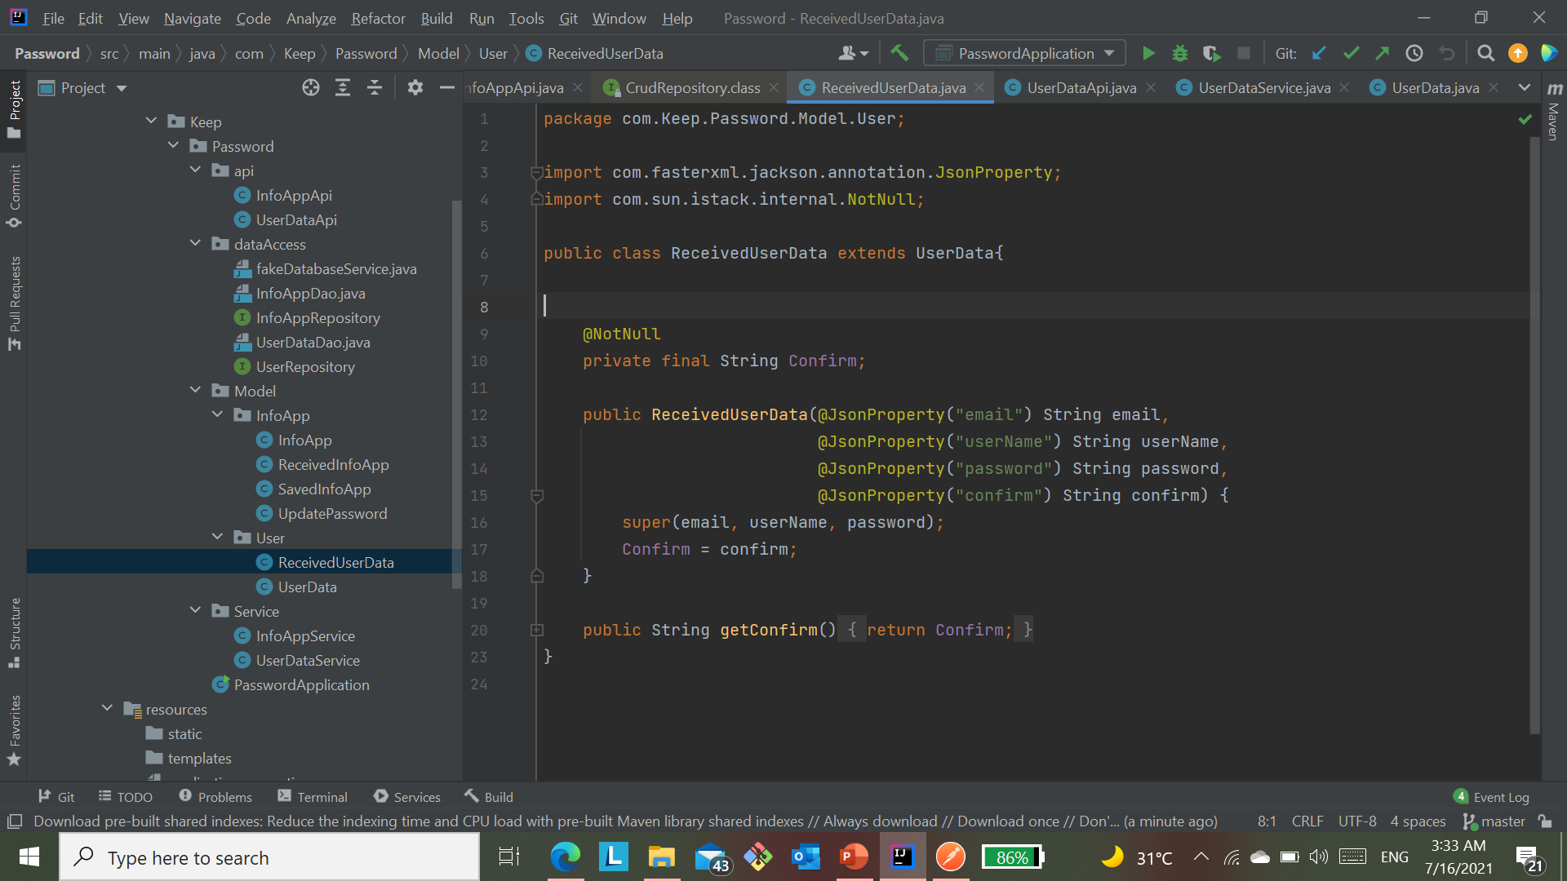
5- Registration Method.
Requirements the user must enter to be registered:
Email.
UserName.
Password.
Confirm.

Slide 33
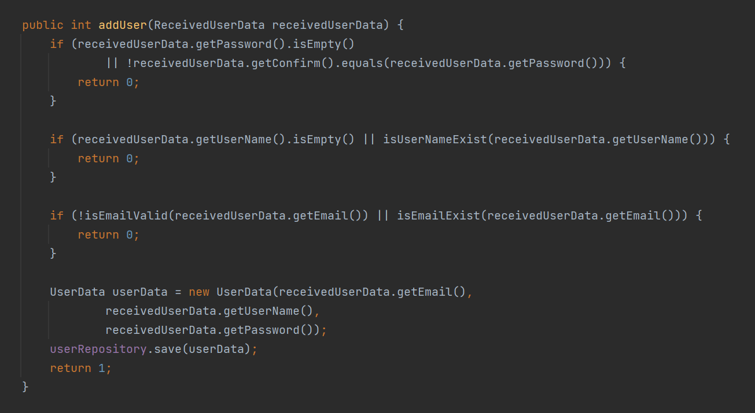
If the entries are empty, the password does not match, or the email and username already exist in the database, is return 0.
Otherwise, the entries are saved in the database, is return 1.

Slide 34
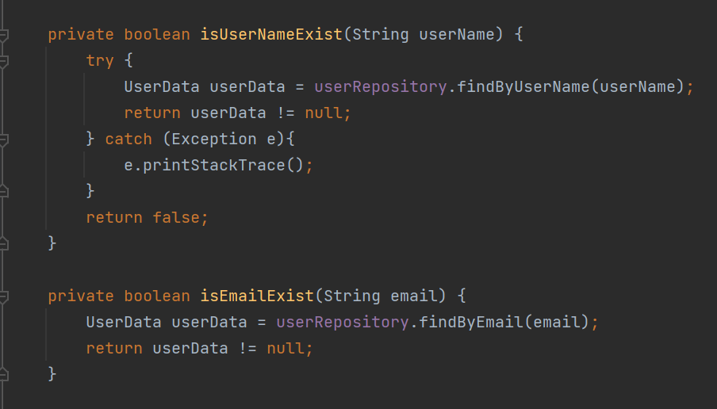
Through these functions isUserNameExist() and isEmailExist(), it is verified that the userName and email are already in the database.

Slide 35
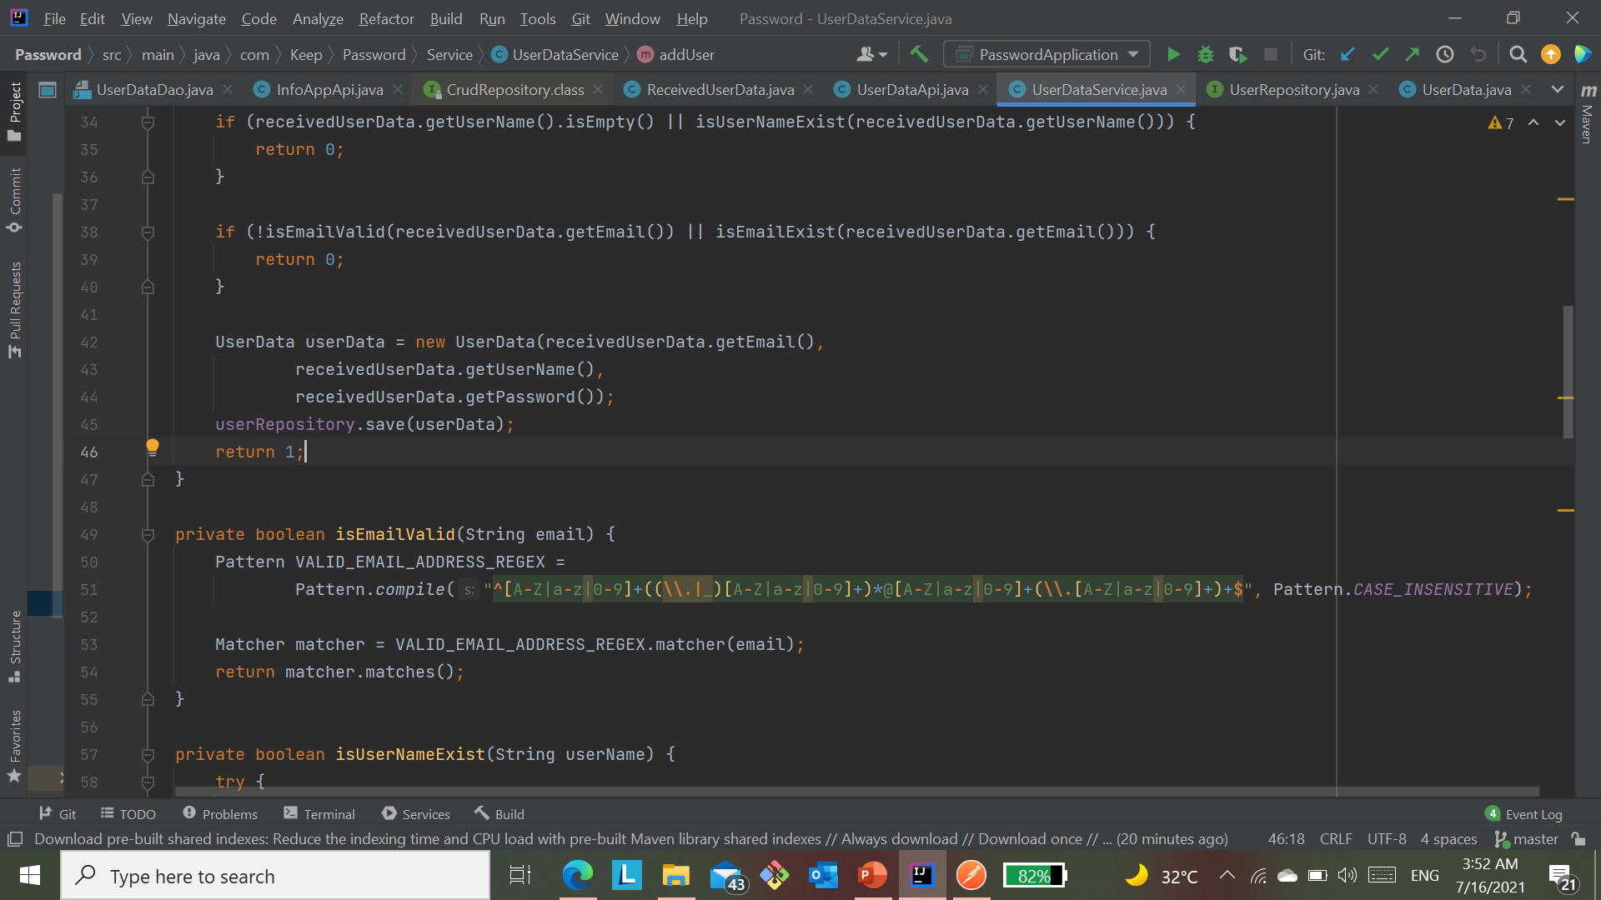
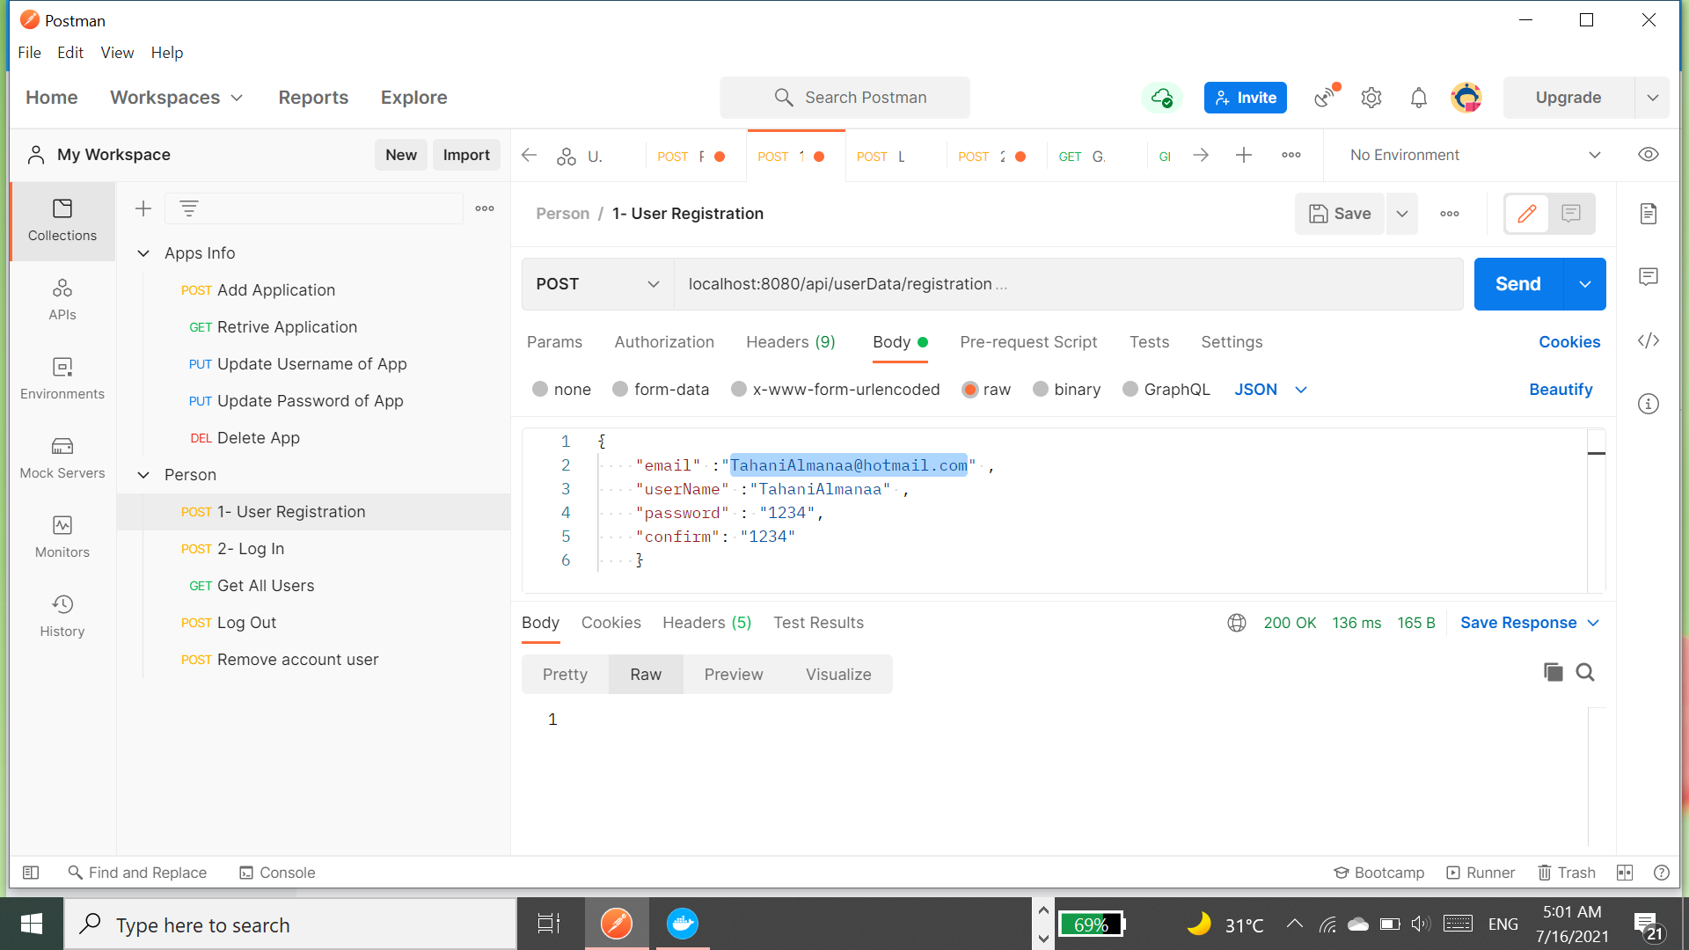
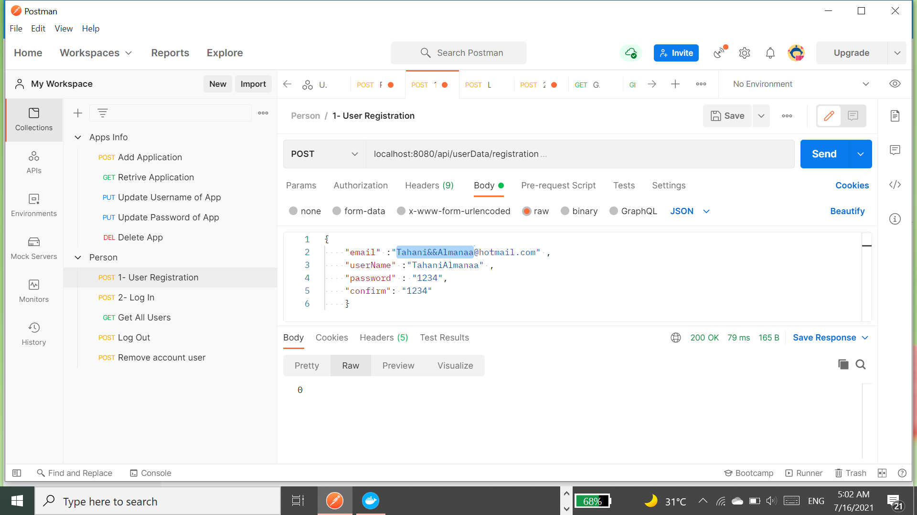
Through this function isEmailValid(), the form of entering the correct email was determined by regex101.
https://regex101.com/

Slide 36
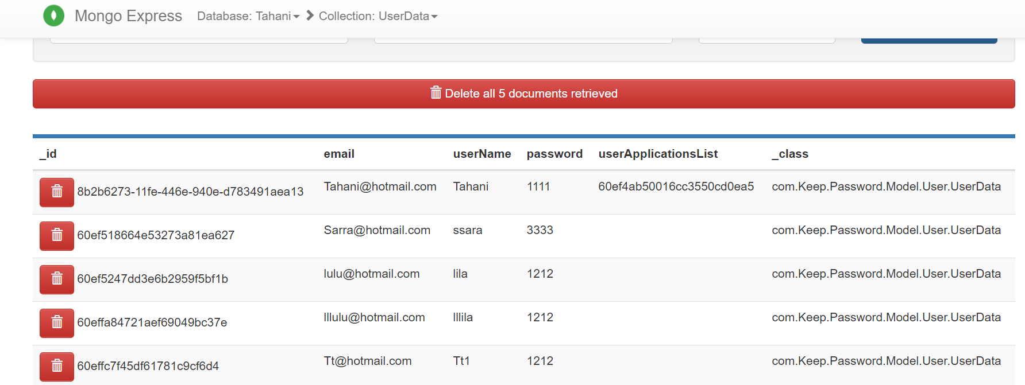
Previous database before add new account.

Slide 37
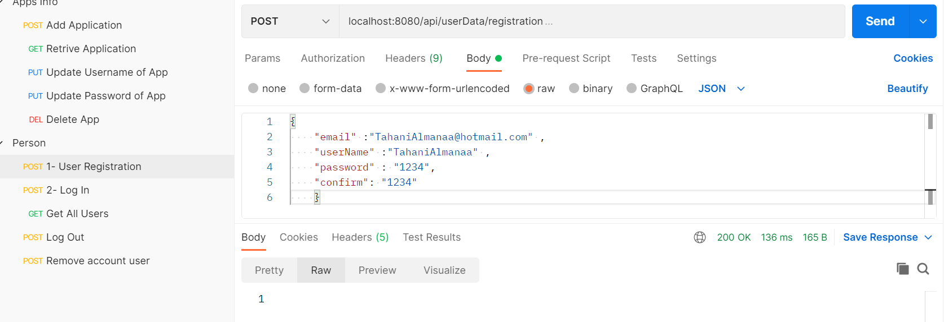
Return 1, if the data was entered correctly.

Slide 38
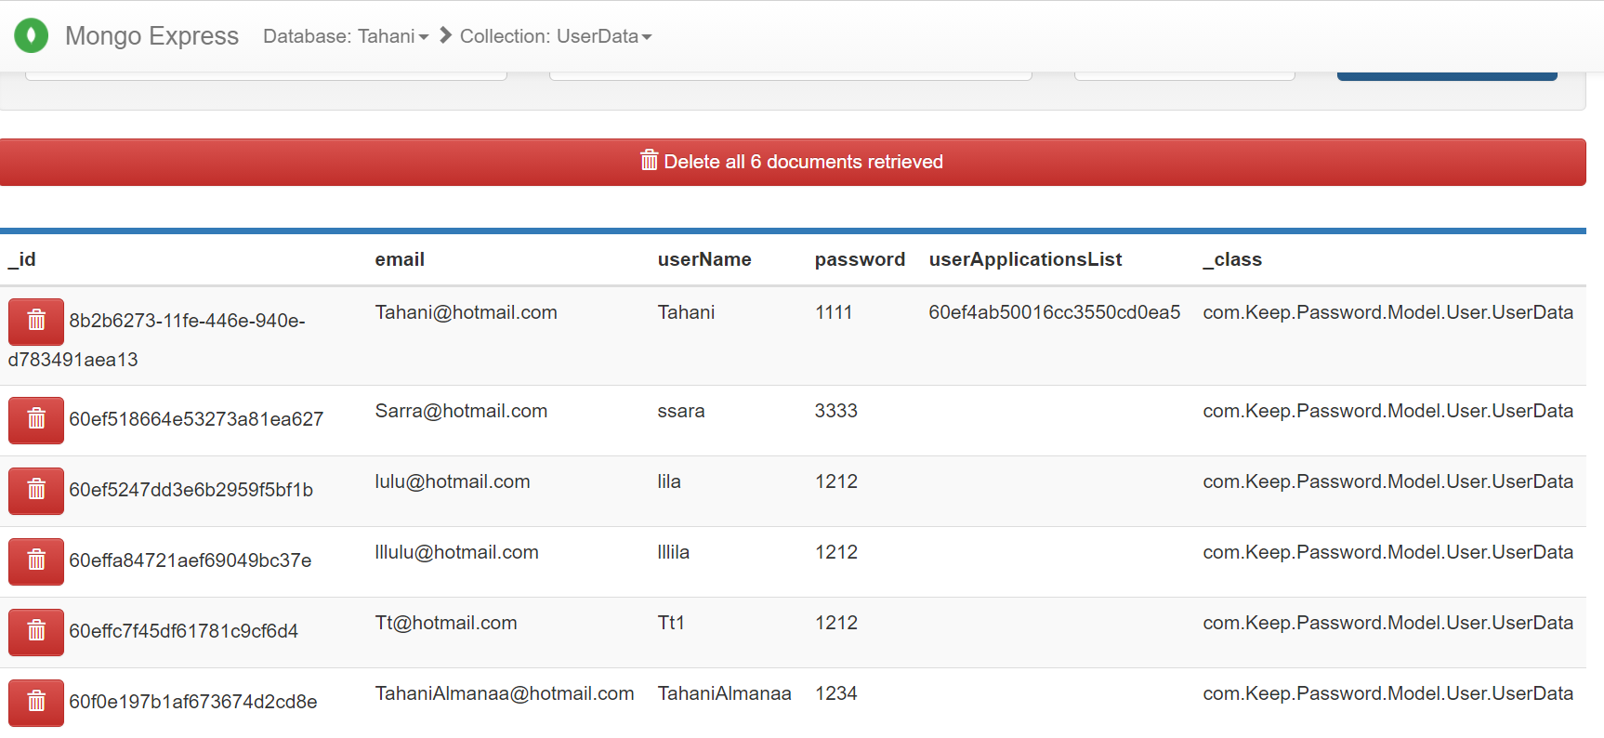
This is the new database after adding the account.

Slide 39
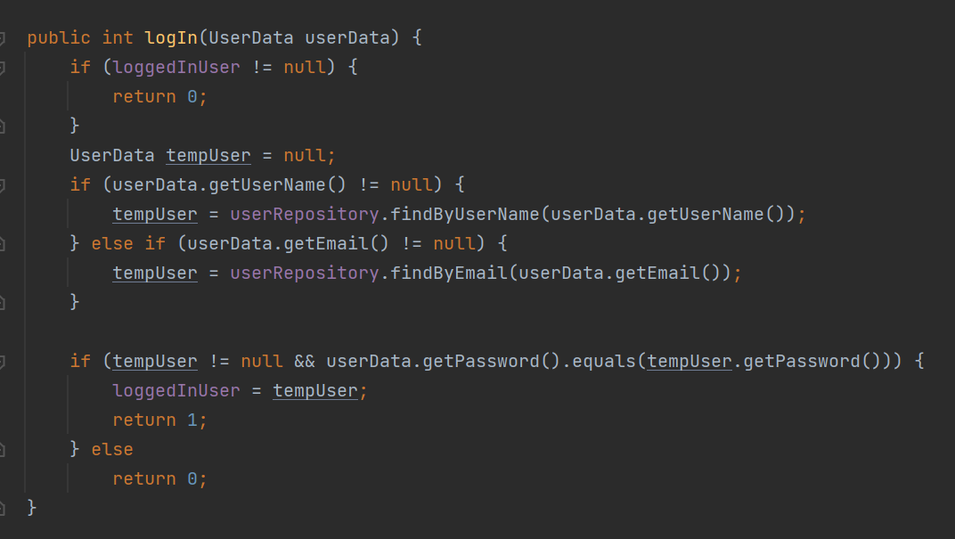
6- Log In Method.
If the user is already logged in before, it will return 0.
If it is not logged in, and the user has an account registered on Keep Password app.
It will be succeeded logging in entered and returns 1.
Otherwise, return 0.

Slide 40


Username and password entered do match what is in the database, return 1.
Username and password entered do not match what is in the database, return 0.

Slide 41
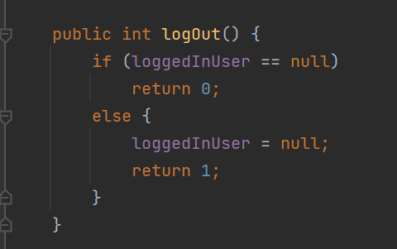
7- Log Out Method.
If the user is not logged in, will return 0.
Otherwise, it will exit and return 1 as successfully logged out.

Slide 42
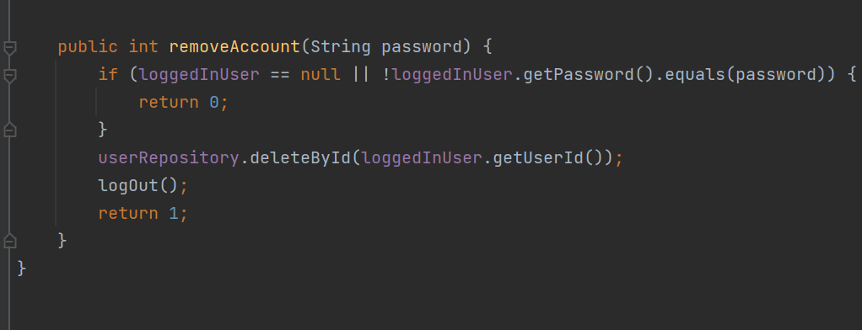
8- Remove account of the user.
The user account will be deleted from the database by entering his password in the account so to make sure that he wants to delete his account.
Will check:
If the user is not logged in or the password entered does not match the password for the account, will return 0.
Otherwise, he will be logged out from the site and his account will be deleted from the database.

Slide 43
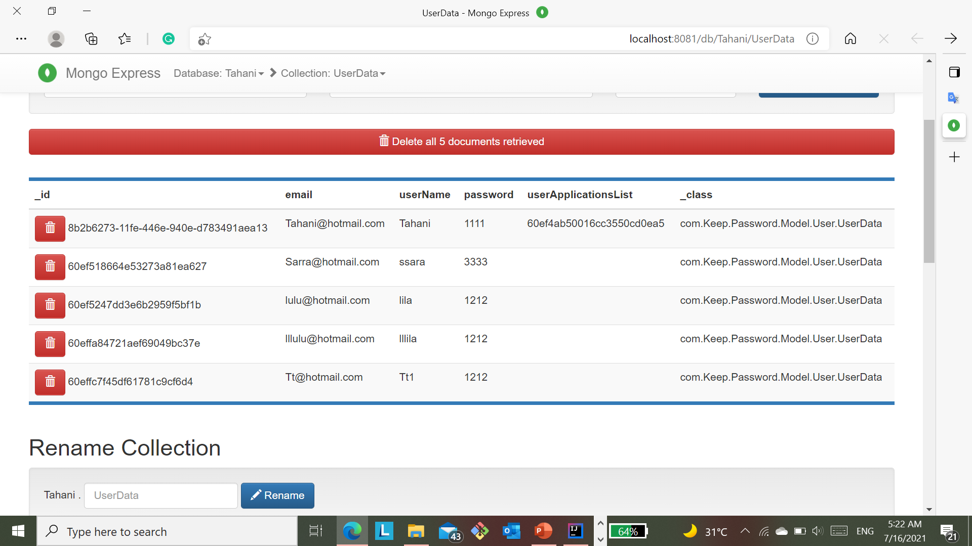
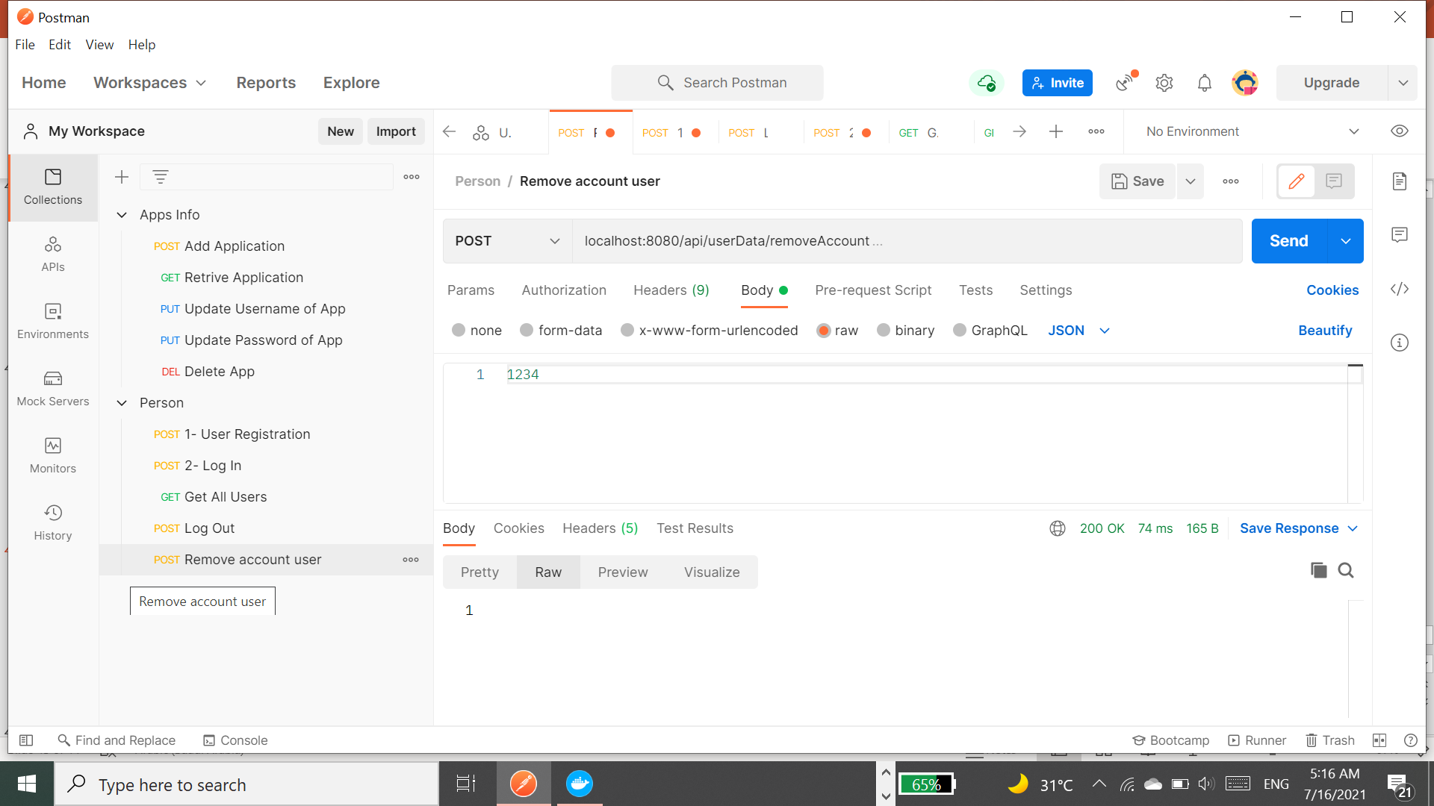
The user account has been deleted from the database.
Database after deleting the account TahaniAlmanaa@gmail.com

Slide 44

TimeLine
The implementation of the application may take 4-6 weeks from start 9 June to 8 July.

